Slide 1
Unit 2
Acoustic Phonetics

Slide 2
Acoustic phonetics: Sound waves
Complex waves.
i) Most sounds are not simple sine waves but complex repetitive waves
ii) Fourier analysis can tell us the series of sine waves which together compose the complex wave.
ii) When the harmonics rise and fall, this means the pitch is

Slide 3
Acoustic phonetics: Sound waves
The individual components of a complex sound wave - harmonics.
The first harmonic is known as the fundamental harmonic.
Its frequency is the fundamental frequency, or F0.
The frequency of the entire complex wave will be the same as that of F0.

Slide 4
Acoustic phonetics: Sound waves
Resonance is the natural vibrating frequency of a body.
Glottal wave: Airflow from the lungs -pressure variations due to the opening and closing of the vocal folds forming a wave.
The vocal tract acts as a resonance chamber for the glottal wave

Slide 5
The frequency of the fundamental harmonic determines the pitch
The frequencies of the other harmonics are integer multiples of the fundamental;
The frequencies of the formants determine vowel quality

Slide 6
Formants are clusters of harmonics with relatively high intensities and energy
Helps in distinguishing vowels (and other sounds)

Slide 7
Spectrograms
Narrow-band vs. wide-band spectrograms: Narrow-band are the ones where you can best see harmonics and pitch;
wide-band are the ones where you can best see formants and time.

Slide 8
Acoustic phonetics: Sound waves
In a wide-band spectrogram individual harmonics are suppressed
it is possible to see individual voicing pulses as vertical striations.
They are most commonly used because in majority of cases we are not interested in the changes of harmonics.

Slide 9
Three types of representation
Spectrum
the amplitudes of the different harmonics
Wave Form
How sound pressure varies over time
Specrogram
A spectrogram is a visual representation of the spectrum of frequencies of a signal as it varies with time.

Slide 10
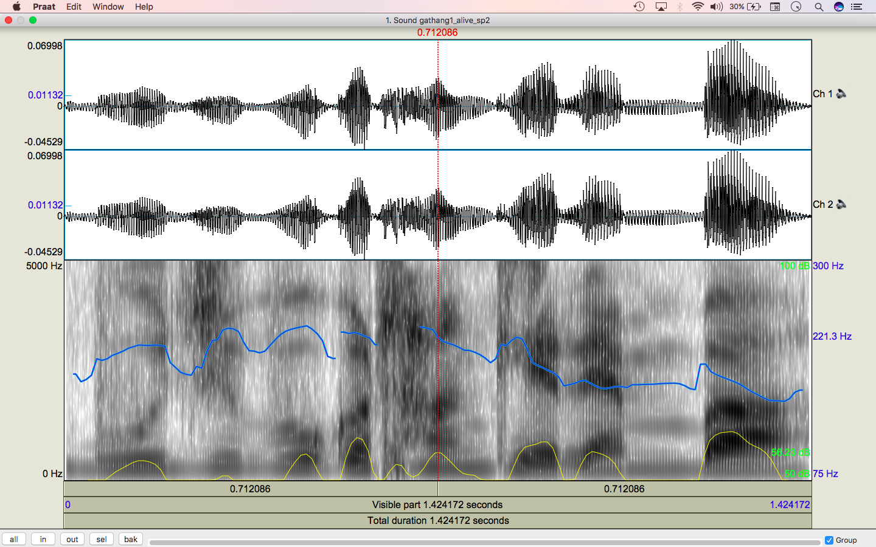

Slide 11
Acoustic phonetics: Sound waves
Source-Filter Theory
sound production consists of two basic parts:
generation of sound source at the glottis
(2) filtering of that source by the vocal tract.

Slide 12
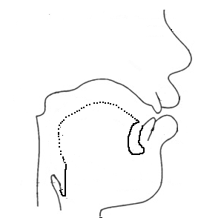
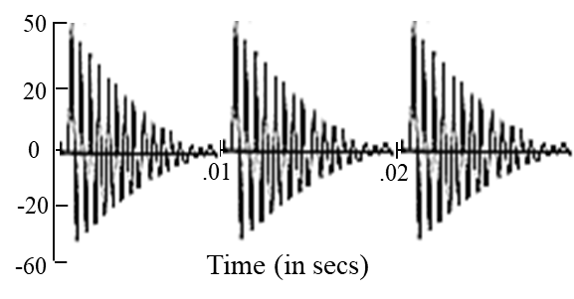
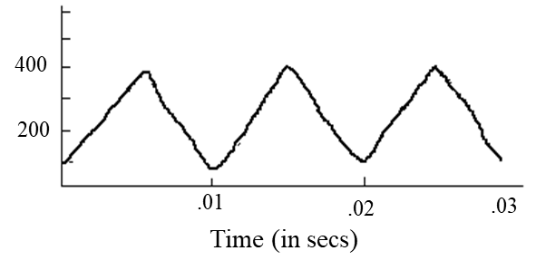

Source filter theory
Output from lips
Glottal airflow
=
Vocal tract filter function
(F0 filtering)

Slide 13
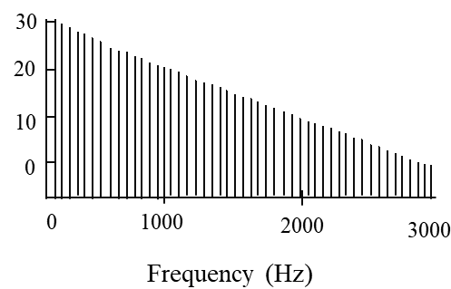
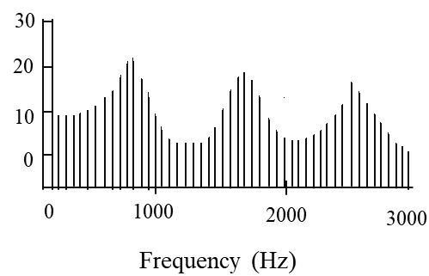
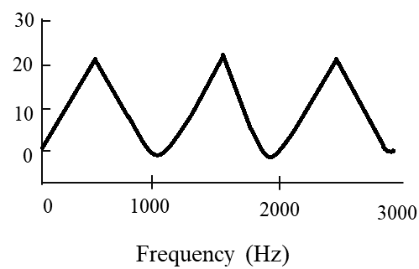
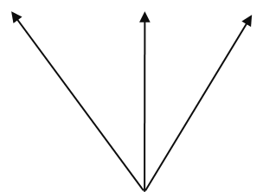
Source filter theory
Source spectrum
Resonance
Output spectrum
Formants frequencies
Vocal tract filter function
(F0 filtering)

Slide 14
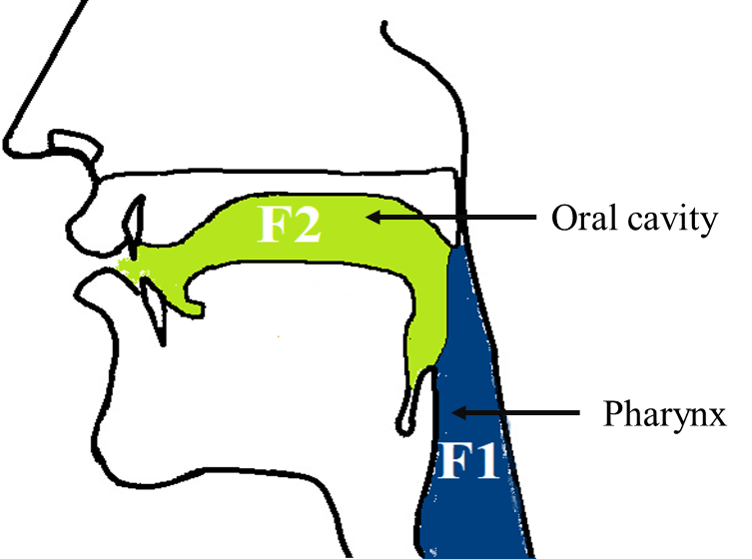
Formants

Slide 15
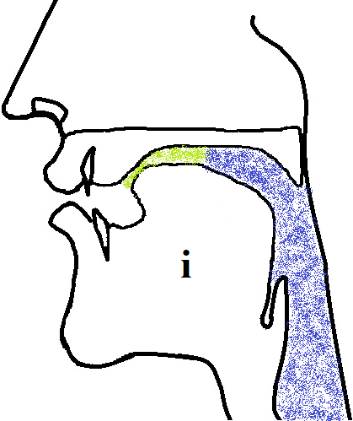
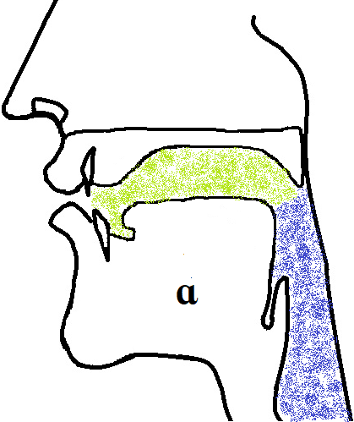
Formants
Oral cavity
F2
Pharynx
F1
Oral cavity
F2
Pharynx
F1
Different resonance chambers and different vowel use for F1 and F2

Slide 16
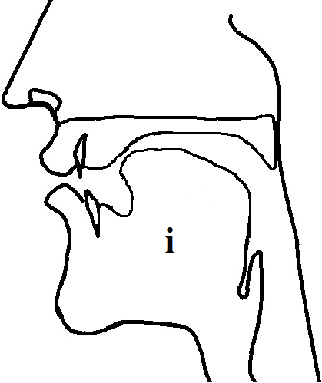
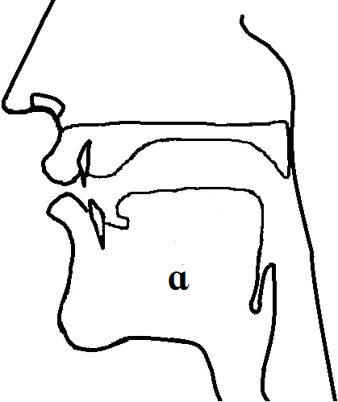
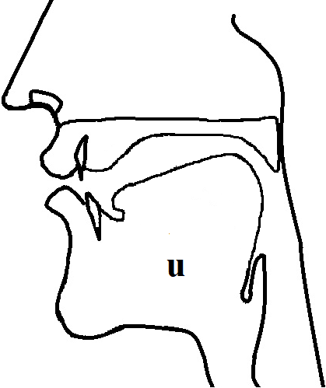
Source filter theory
Different vocal tract shapes lead to different frequencies

Slide 17
Vowel quality
The lower the F1, the higher the vowel. [a] has the highest F1.
The lower the F2, the further back the vowel.
The lower the F3, the further back the vowel (although this is less significant).
The closer F1 and F2 are to each other, the lower the vowel (and possibly further back).
Rounded vowels will have all formants slightly lower than unrounded counterparts

Slide 18
Manner of articulation
Oral stops will show as gap
Aspirated stops will show a bit of noise before the next vowel.
Fricatives will show as noise.
[s z] will show the highest-frequency and strongest frication, while labial fricatives
will not be so strong

Slide 19
[h] will show very, very faint noise, but mostly show the following vowel’s formants. F2 is also slightly raised, and F3 slightly lowered, towards the [h]
Nasals will have a weak formant-like pattern.
Rhotics will show a lowered F3 at the transition and even throughout much of the next vowel.
Laterals also show weak formants. [ l] will have three distinct formants

Slide 20
Place of articulation
F2 at the transition
For labials, F2 will point down towards the consonant.
For velars, F2 will point up, while F3 may point down a bit.
For coronals, F2 should remain level.

Slide 21
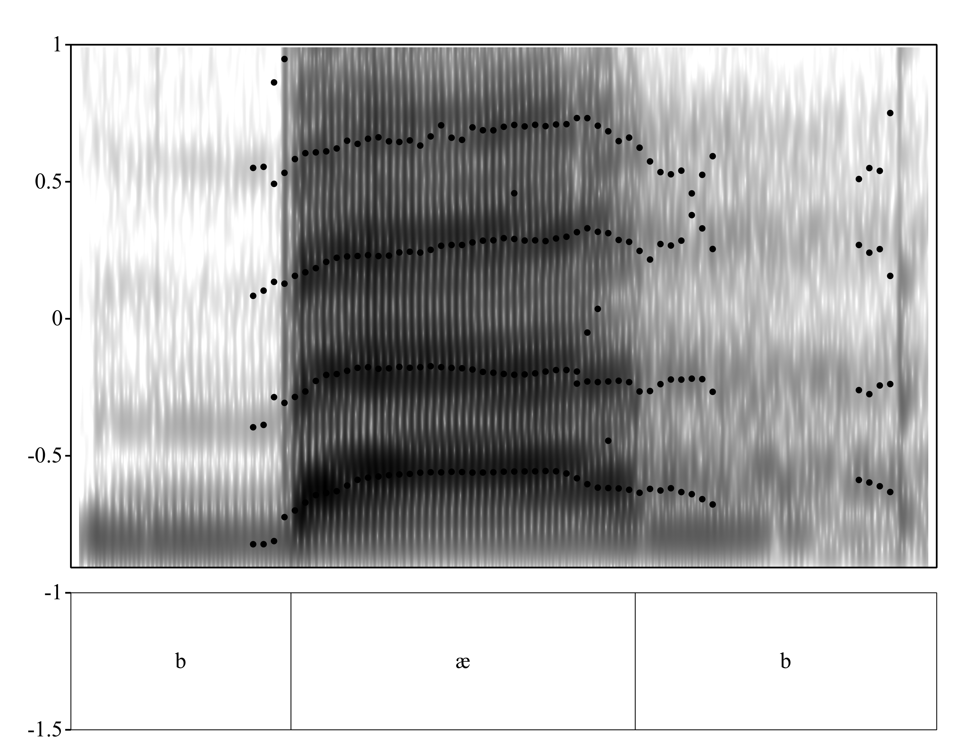


Slide 22
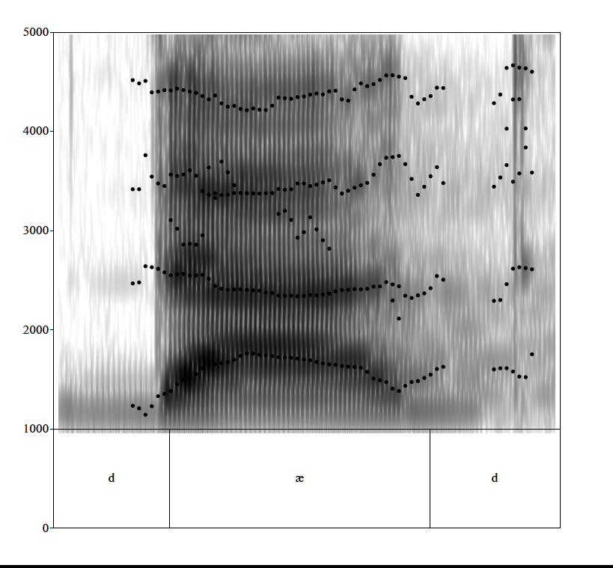

Slide 23
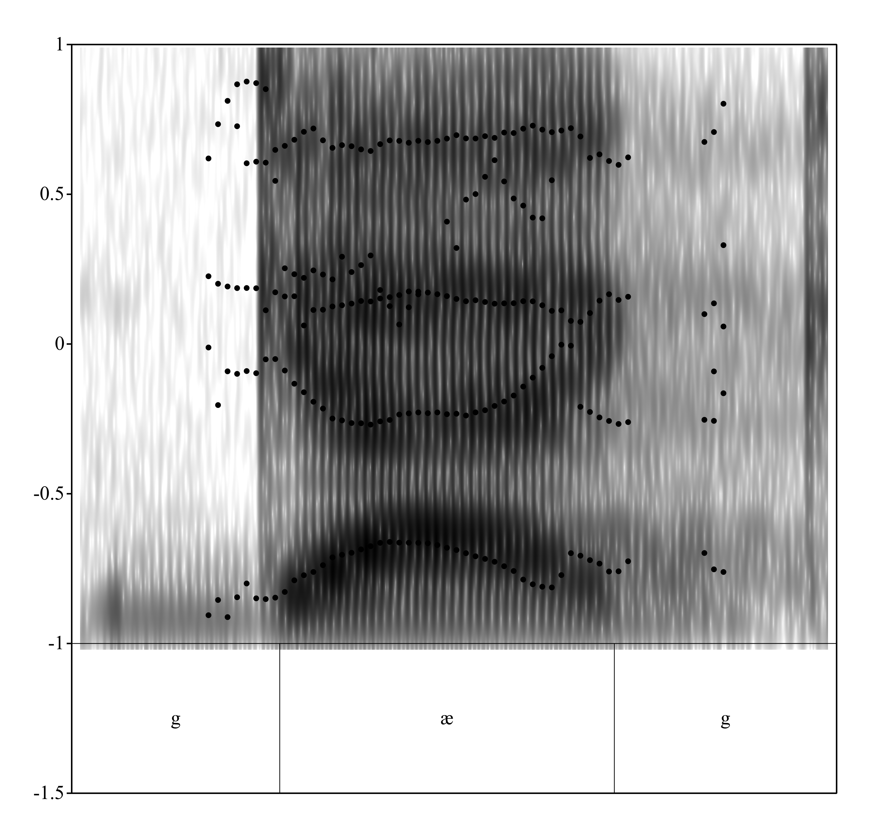

Slide 25
the transitions in the F2 of /bab/ point down
In /gag/ the F2 and F3 come together.
the F3 of /dad/ goes up slightly
Labial –downward transition
Velar - F2 and F3 transitions that come together - 'velar pinch’
Coronals – F3 upward transition
.

Slide 26
burst energy.
the bursts for "dad" are stronger than the others.
The energy of the bursts in "gag" are in the F2/F3 region,
The burst of [b] is is all over not concentrated

Slide 27
English plosives occur at three places of articulation—
lips 2) alveolar region 3) velum
The bilabial plosives, [p] and [b] are articulated with the lower lip pressed against the upper lip.
The coronal plosives [t,d] are made with the tongue blade pressing against the alveolar ridge
[k] and [g] are articulated in the velic region with the tongue body
During a closure there is silence
The gap shows a plosive
the transitions into and out of the closure – the formant transitions inform us about the place of articulation

Slide 28
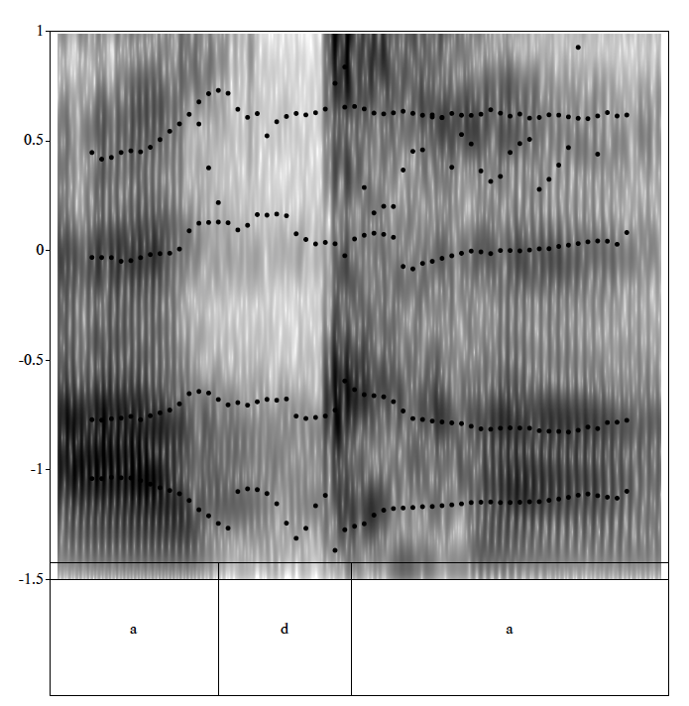

Slide 29
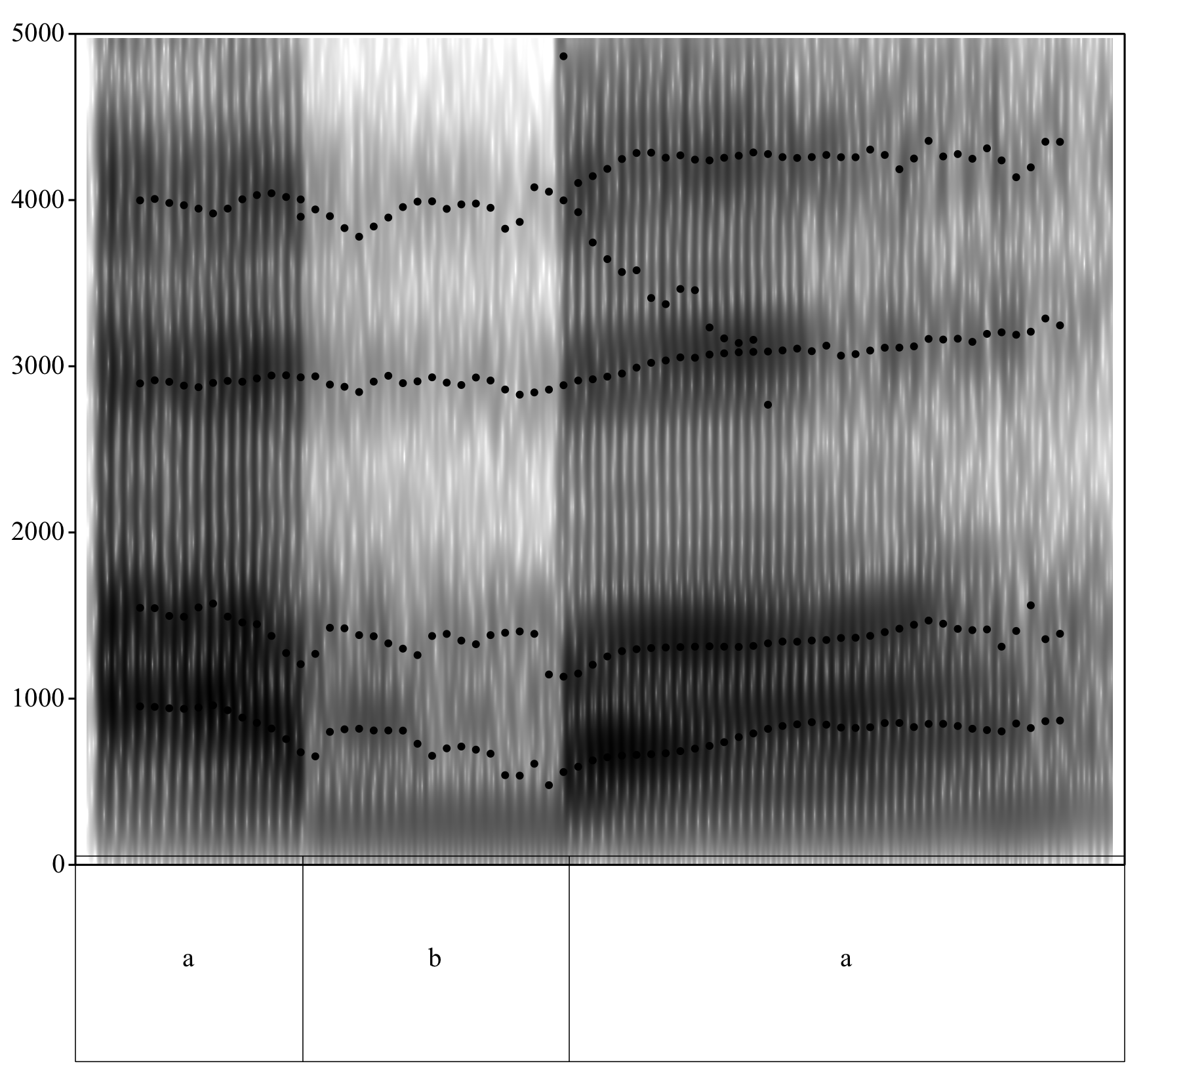

Slide 30
Plosives (oral stops) involve a total occlusion of the vocal tract i.e. no resonances being contributed by the vocal tract
The result a period of silence in the spectrogram, known as a 'gap'.
A voiced plosive may have a low-frequency voicing bar of striations,

Slide 31
There's no voicing during the initial closure of any of these plosives
Then suddenly, there's a burst of energy and the voicing begins, followed by an abrupt loss of energy
The first burst of energy is the release of the initial plosive.
loss of energy at most frequencies - closure

Slide 32
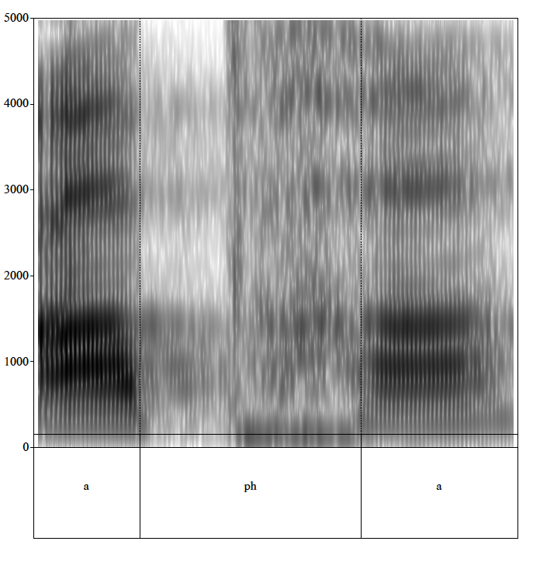

Slide 33
Fricatives
acoustically and aerodynamically complex
There is noise or frication
Frication noise is generated in two ways

Slide 34
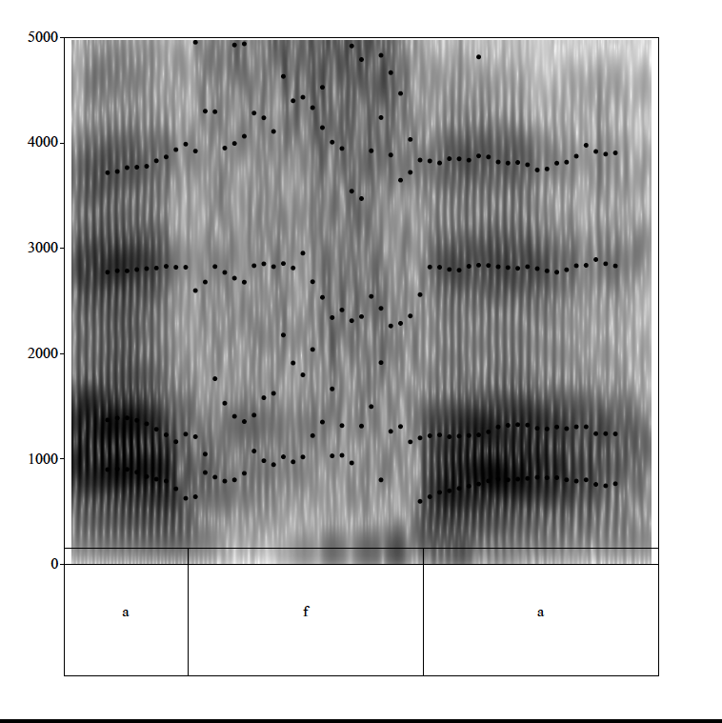

Slide 35
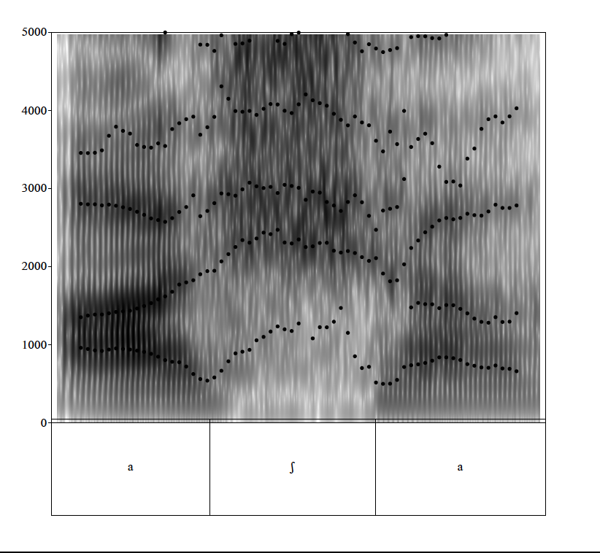

Slide 36
Sibilant fricatives - a jet of air is pushed against the teeth.
The result is very high amplitude noise.
Non-sibilant fricatives are channel fricatives, particularly bilabial and labiodental fricatives
Channel fricatives – lot of air bouncing off and creating turbulence

Slide 37
The darkest part of [s] noise is in higher frequencies
[s] is centered (darkest) above 8000 Hz.
ʃ noise is near formant 3 or 4.
[z] and [ʒ]have
a) lesser amplitude
b) shorter duration of frication
c) a voicing bar

Slide 38
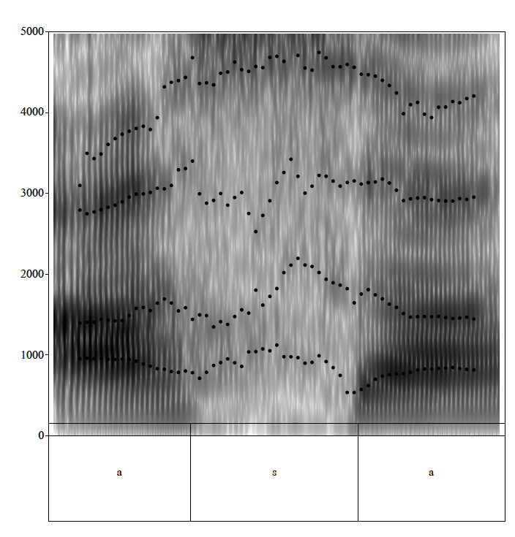

Slide 39
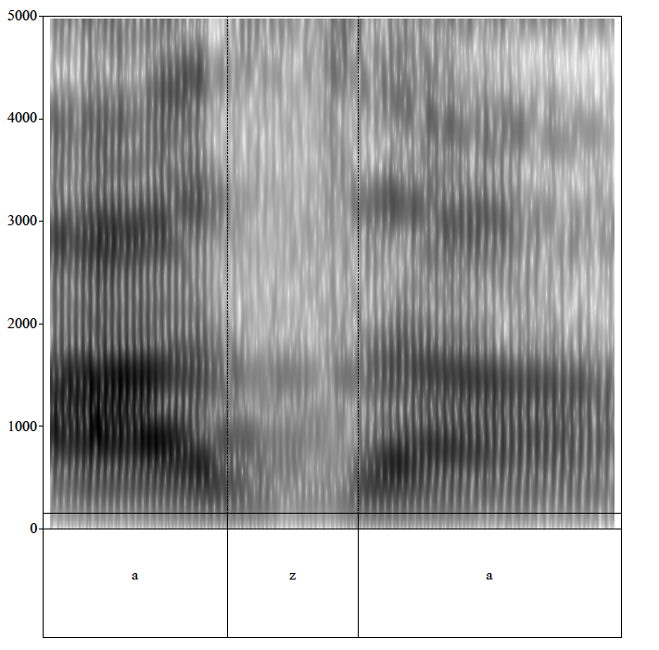

Slide 40
Labiodental and (inter)dental (nonsibilant) fricatives are difficult to distinguish, since they're made at about the same place in the vocal tract
They sometimes look like approximants

Slide 41
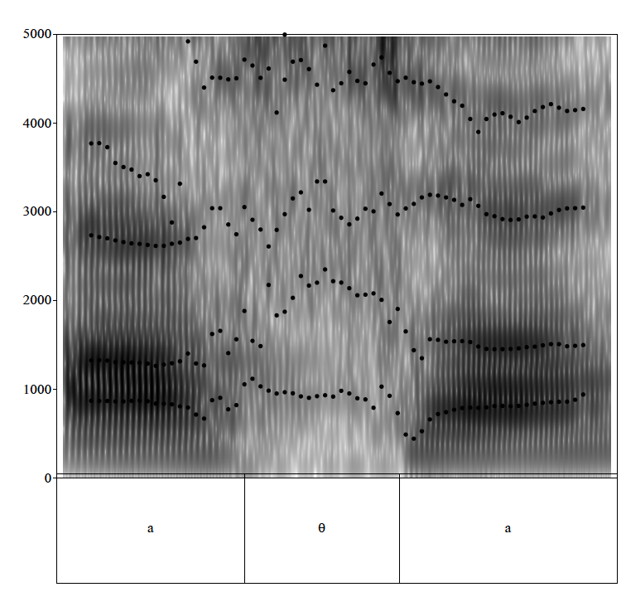

Slide 42
[h].
[h] is always described as a glottal fricative,
It shows formants in spectrograms
The noise will be clearly seen in formant regions.

Slide 43
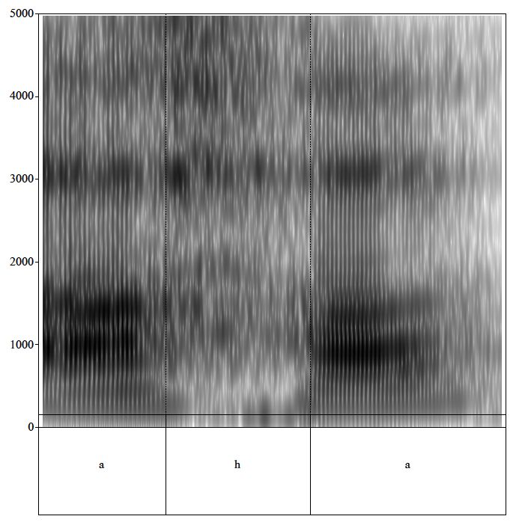

Slide 44
the approximants are non-vowel oral sonorants.
In English
/l, r, w, j/. They have formant structure (like vowels)
F1 is mid-to-high – a more open constriction
In /w/ the F2 is very low

Slide 45
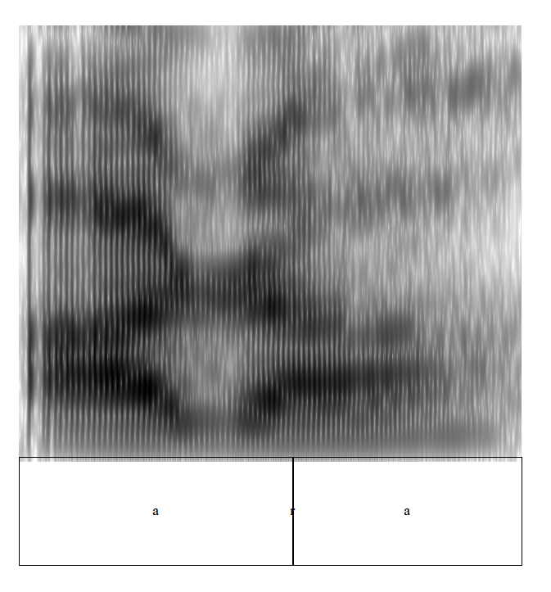

Slide 46
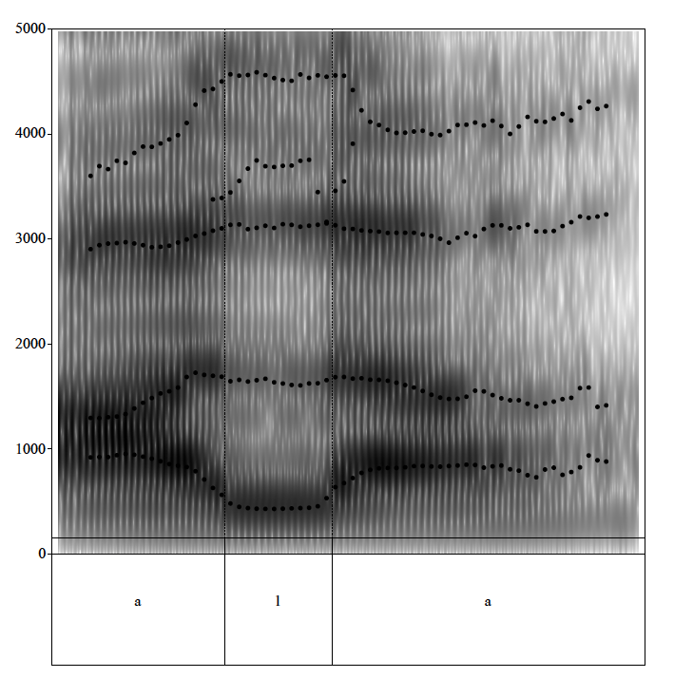

Slide 47
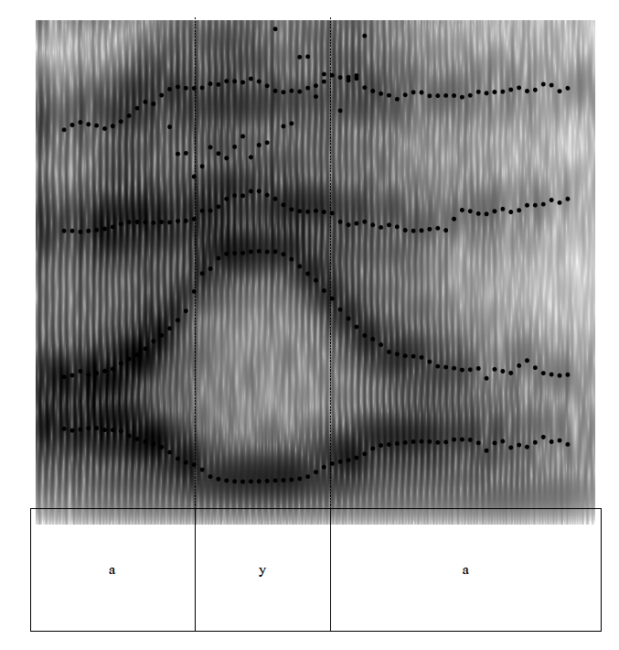

Slide 48
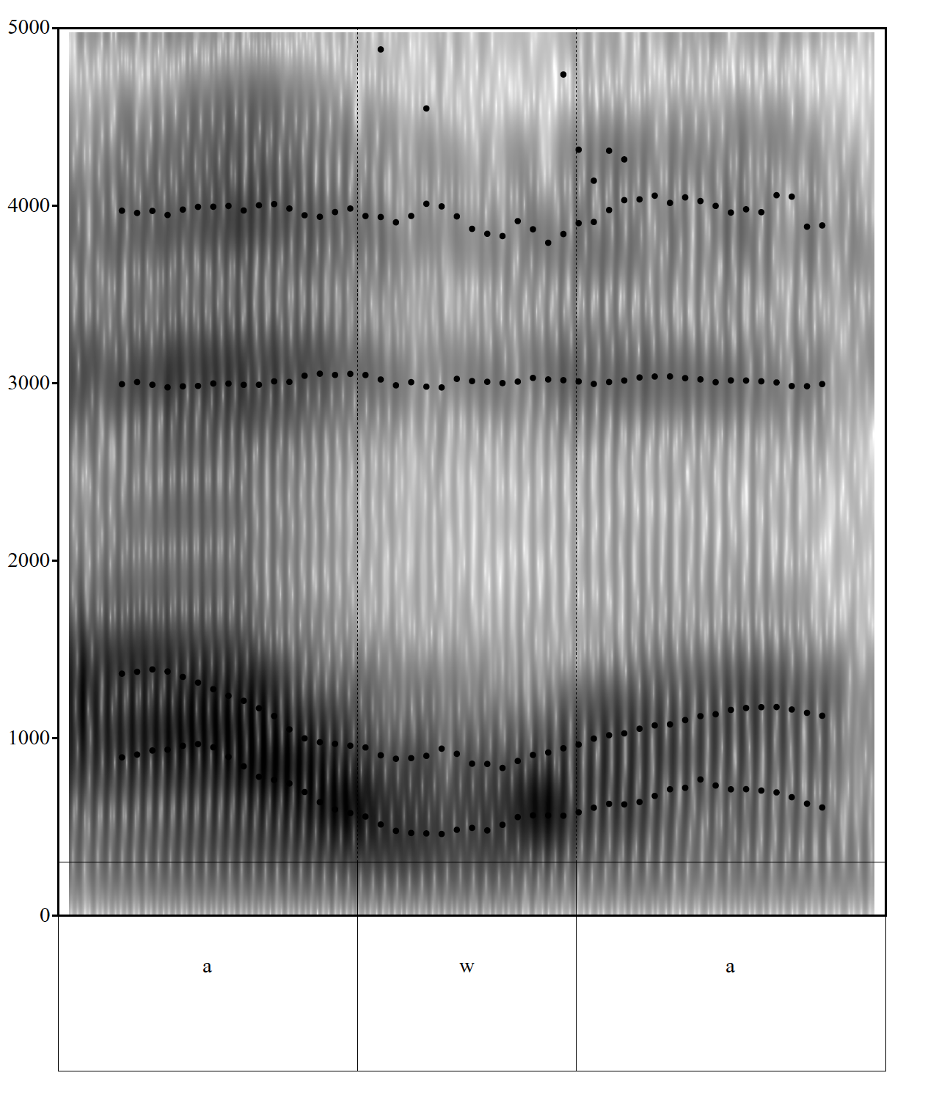

Slide 49
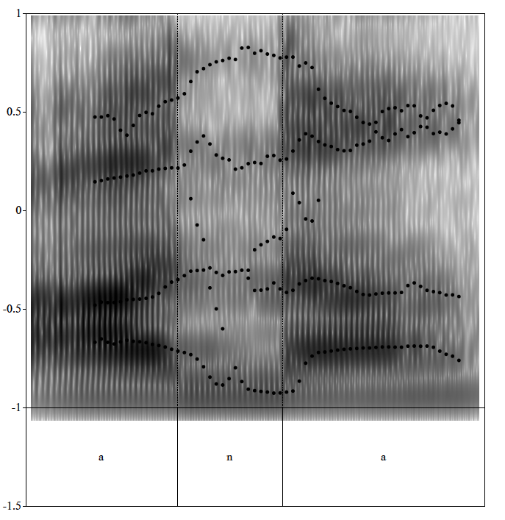

Slide 50
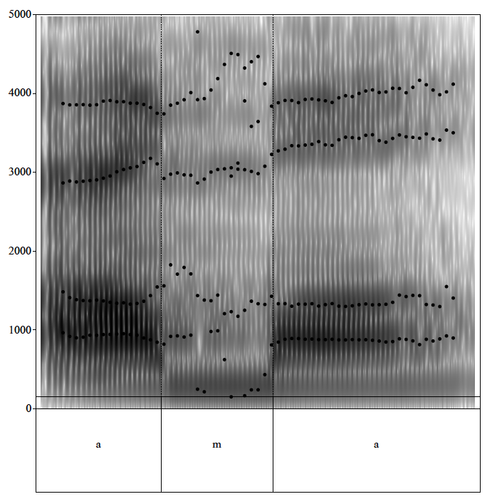

Slide 51
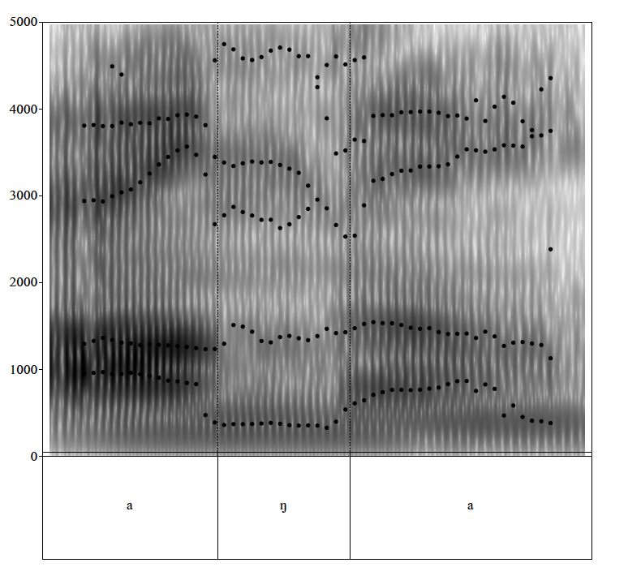

Slide 52
Nasals have formant structure
relative 'zeroes' or areas of little or no spectral energy.
a) formant structure
b) relatively low vowel amplitude.
Nasal pole and zero

Slide 53
Glottal source waveform and spectrum vary depending on the type of phonation –
Modal
Creaky
breathy

Slide 54
There are two types of sound sources involved in speech production:
Periodic glottal voicing source
Aperiodic source

Slide 55
Consonants
the vocal tract filter modulates the input from the sources
different frequency components of the source are passed through the vocal tract filter

Slide 56
These sources may be combined
production of voiced fricatives - periodic laryngeal source
aperiodic noise generated in the vocal tract.

Slide 57
Production of voiced stops combines all three sources.
.

Slide 58
nasals, liquids and glides
periodic glottal source with vowels.
But their filtering effects are more complicated.

Slide 59
Nasals and laterals are characterized by a closed tube.
velum is lowered
In nasal stops, the mouth cavity is closed

Slide 60
Other characteristic properties of nasals include: (i) low F1 (nasal murmur) - 250-300 Hz
(ii) weaker than in vowel sounds, i.e. the peaks are lower in amplitude

Slide 61
The release burst is very brief transient noise which has a flat spectrum.

Slide 62
strength hierarchy of burts:
voiceless aspirated
voiceless unaspirated
voiced.

Slide 63
burst spectrum of voiceless stops has more energy than that of voiced stops.
The source spectra for aspiration and frication are same

